Slide 1


Slide 2

Java OOP and Data Structures with Introduction to Secure Coding Dr. Ziping Liu
Chapter 16 Binary Trees

Slide 3
https://he.kendallhunt.com/product/java-oop-and-data-structures-introduction-secure-coding
Chapter 16 Binary Trees

Slide 4

Chapter Outlines
What is a binary tree
What is a binary search tree
Searching in a binary search tree
Insertion in a binary search tree
Recursive traversal (depth-first traversal) in a binary search tree
Deletion in a binary search tree
Level-order traversal (breadth-first traversal) in a binary search tree
Java’s TreeSet implementation
Huffman tree

Slide 5
16.1 What Is a Binary Tree?
a tree structure
a collection of nodes connected by directed edges or arcs
an acyclic structure - contains no cycles
one unique path between any two nodes in the tree
follow a hierarchical model
the node at the top of the hierarchy known as the root node
has only one root node, which does not have any incoming edges. All other nodes in the tree have exactly one incoming edge

Slide 6
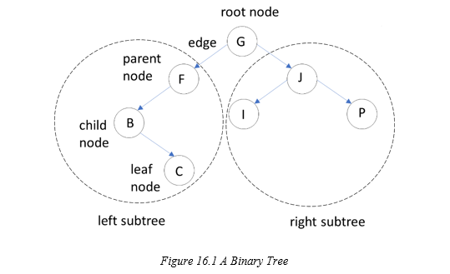
16.1 What Is a Binary Tree?
binary tree
each node has at most two child nodes

Slide 7
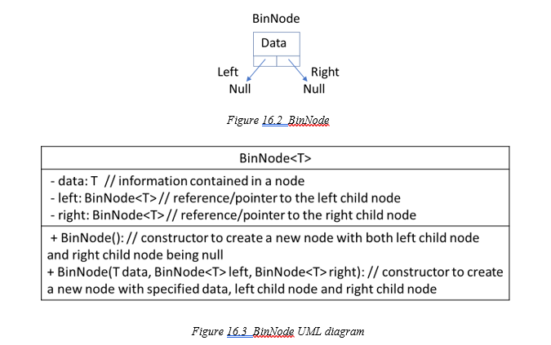
16.1 What Is a Binary Tree?
binary tree ADT can be implemented using a linked structure

Slide 8
16.2 What Is a Binary Search Tree?
a specialized type of binary tree where all elements in the left subtree are less than or equal to the root node, and all elements in the right subtree are greater than the root node
When inserting an item into a BST, this ordering rule must be strictly followed
In a BST, items are unique, meaning duplicates are not allowed
fast item look-up

Slide 9
16.2 What Is a Binary Search Tree?
Assume the following numbers are inserted into a binary search tree (BST) in the given order:
55, 50, 38, 51, 39, 65, 57, 80, 59

Slide 10
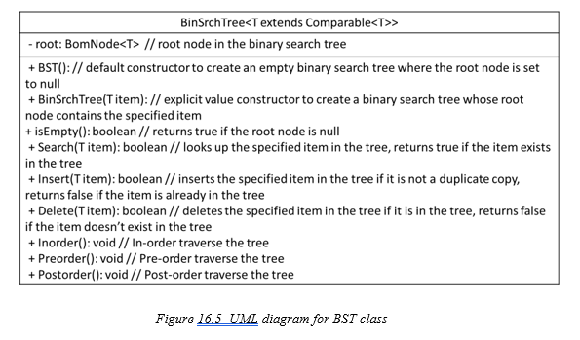
16.2 What Is a Binary Search Tree?

Slide 11
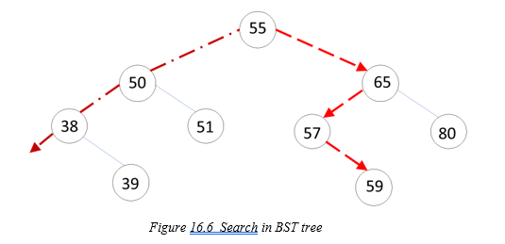
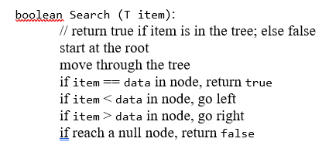
16.3 Searching in BST
searching for two numbers: 59 and 31

Slide 12
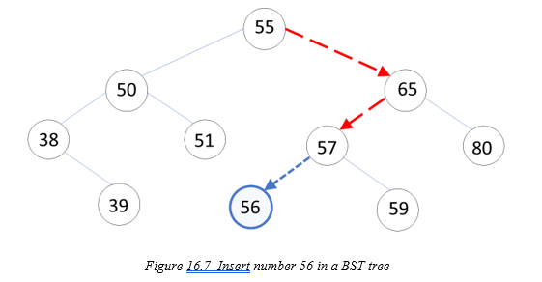
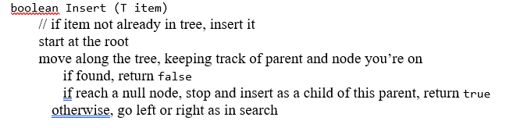
16.4 Insertion in a Binary Search Tree
To insert a new item, such as 56, into the tree

Slide 13
16.5 Recursive Traversal/Depth-first Traversal in a Binary Search Tree
InOrder (LNR) Traversal: Visit the Left subtree, then the Node, and finally the Right subtree
PreOrder (NLR) Traversal: Visit the Node first, followed by the Left subtree, and then the Right subtree
PostOrder (LRN) Traversal: Visit the Left subtree, then the Right subtree, and finally the Node
LNR, NLR and LRN: depth-first search traversal

Slide 14
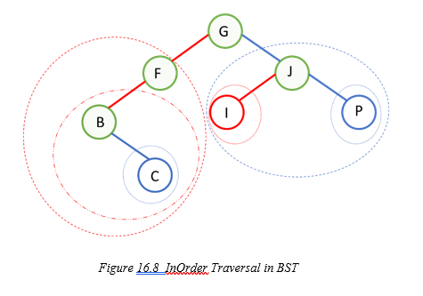
16.5 Recursive Traversal/Depth-first Traversal in a Binary Search Tree

Slide 15


Slide 16


Slide 17
16.6 Deletion in a Binary Search Tree
Single Node Tree: If the item’s node is the only node in the tree, reset the root node to null.
Item at the Root Node: If the item is at the root, update the root node after the deletion process.
Item at a Leaf Node:
Identify the parent of the leaf node.
If the leaf node is the left child of its parent, set the parent’s left child to null.
If the leaf node is the right child, set the parent’s right child to null.
Item with a Single Child:
Determine whether the node is the left or right child of its parent.
Replace the node in the parent’s left or right child pointer with the node’s single child.
Item with Two Children:
Swap the item with its in-order successor (the next item in ascending order).
The problem is then reduced to either a leaf node case or a single child node case, and handled accordingly.

Slide 18
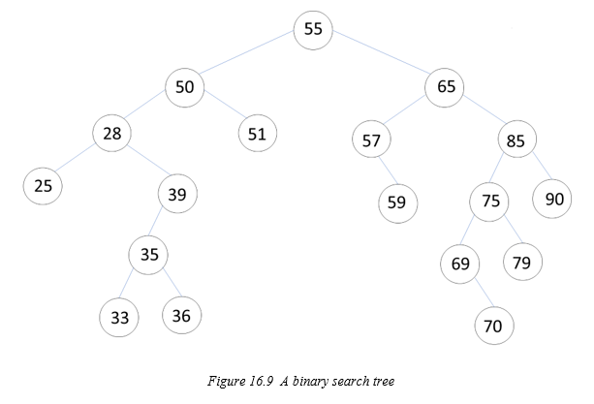
16.6 Deletion in a Binary Search Tree
delete the numbers 36, 39, and 65 from the tree

Slide 19
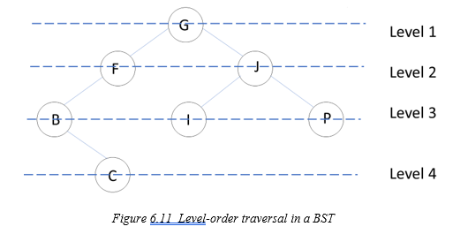
16.7 Level-order Traversal/Breadth-first Traversal in Binary Search Tree
traverse nodes level by level, starting from the root: level-order traversal or breadth-first traversal

Slide 20
16.7 Level-order Traversal/Breadth-first Traversal in Binary Search Tree
Steps for Traversal:
Initialize the Queue: Before starting the traversal, enqueue the root node into the queue.
Traverse the Tree: Begin traversal by dequeuing the front node from the queue. If the dequeued node has child nodes, enqueue them into the queue.
Output Nodes by Level: To output nodes level by level, use an outer loop to iterate over the levels and an inner loop to process nodes at the current level.

Slide 21
16.8 Java Collections TreeSet Usage
Java Collections Framework support for tree-based abstract data types
java.util.TreeSet<E>
java.util.TreeMap<K, V>

Slide 22
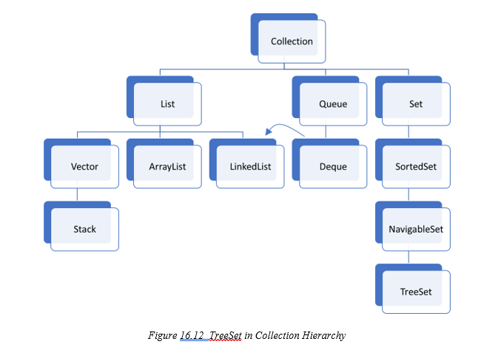
16.8 Java Collections TreeSet Usage
TreeSet<E> implements java.util.Set<E> interface, java.util.SortedSet<E> interface, java.util.NavigableSet<E> interface

Slide 23
16.9 Huffman Tree
Huffman coding
a compression scheme that uses variable-length binary codes to represent characters
The codes are composed of 0s and 1s
Characters that occur more frequently are assigned shorter codes, while less frequent characters are assigned longer codes
Huffman codes are also immediately decodable, meaning no character's code is a prefix of another character's code

Slide 24
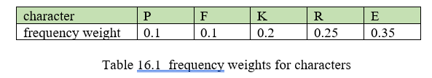
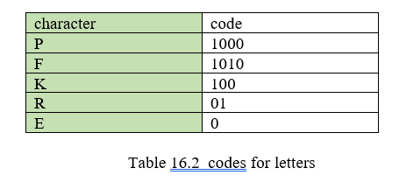
16.9 Huffman Tree
Violates the rule of immediately decodable

Slide 25
16.9 Huffman Tree
Algorithm for Huffman encoding:
Given: list of characters and their weights (probabilities that they will occur)
Sort in ascending order of weights
Build a double tree, bottom up, from the weights:
Combine the two smallest into a subtree with their sum as the root and the weights as the left and right children.
Repeat until all weights are leaves of the combined tree
In the path to a character, output each left pointer as a 0, and each right pointer as a 1.

Slide 26
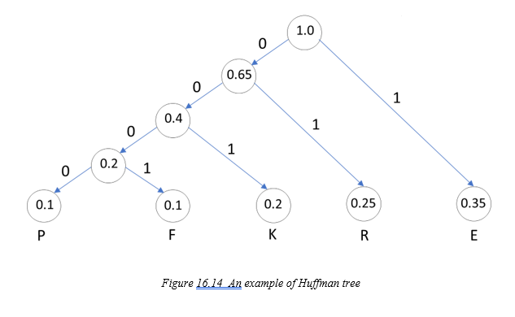
16.9 Huffman Tree
P: 0000
F: 0001
K: 001
R: 01
E: 1

Slide 27
16.9 Huffman Tree
Huffman decoding algorithm:
Read in list of characters and their Huffman codes.
Build a character tree, top-down, from this list (0 goes left, 1 goes right; fill data with an ‘*’ until reach the leaf, then fill with the character).
Read in an encoded message. Decode it by following the bits through the tree to the encoded character.

Slide 28
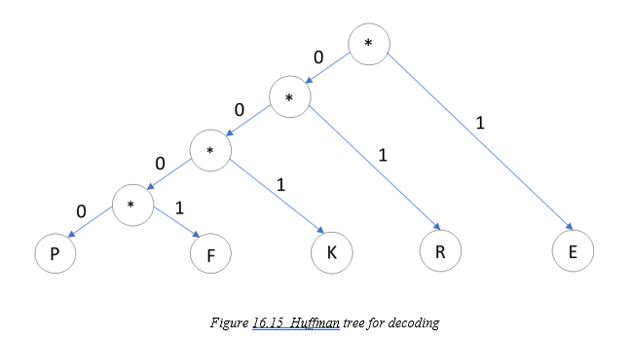
16.9 Huffman Tree
Assuming we encounter the following secret message: 1010000001, we would like to decode it. gives us the letters: ERPF.

Slide 29
Which National Part is it?
Saguaro National Park

